Slide 1

CSE 225 Data Structures and Algorithms Sec- 5&6
Fall-2018
Instructor : Tamanna Motahar

Slide 2
Lecture 1

Slide 3
Data Structure
The study of Data and how to represent data objects within a program
ADT : Abstract Data Type
An abstract data type is a mathematical set of data, along with operations defined on that kind of data
Algorithm
A logical sequence of discrete steps that describes a complete solution to a given problem, computable in a finite amount of time.

Slide 4
Data Structures: Why?
Data: Information that is processed by computer program.
Program design depends crucially on how data is structured for use by the program
Implementation of some operations may become easier or harder
Speed of program may dramatically decrease or increase
Memory used may increase or decrease
Debugging may be become easier or harder

Slide 5
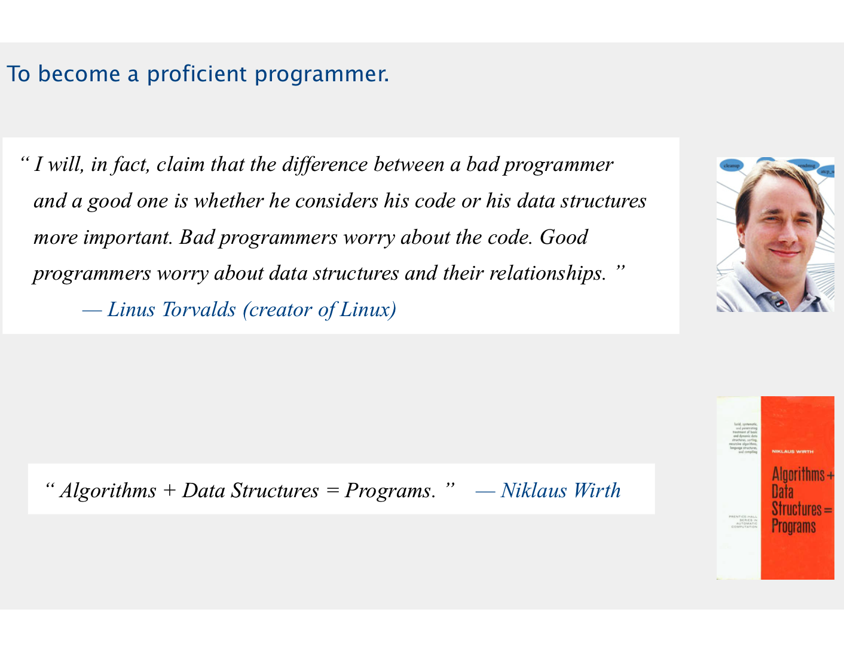
Why Study Algorithms and Data Structures?
To become better computer scientist

Slide 6
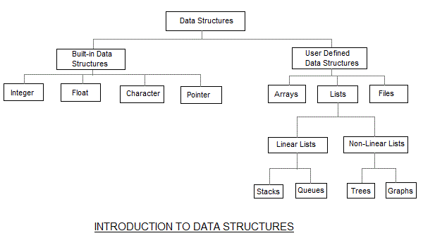

Slide 7
Two Data types:
1. Primitive Data Type:
- Basic Unit of Language
- Each Primitive value is a single datum
Example: int , char, string etc.
2. Composite Data Type:
- Multiple pieces of related data as a single datum
- We can create object as a single datum and then create instances for the object
Example: Array,
Records, Class
Movie clip etc.
** What are the differences between Primitive and Composite Data Types??

Slide 8
Composite Data Type
Structured (Arrays)
Unstructured (Classes and Structures)
In modeling data in program, we consider data from three different perspective:
Application (or user) level: A way of modeling real-life data in a specific context, also called the problem domain.
Logical (or abstract) level: An abstract view of the data values and the set of operations to manipulate them
Implementation Level: A specific representation of the structure to hold the data items

Slide 9
Structured Data Type (Arrays)
Stores a fixed-size sequential collection of elements of the same type.
All arrays consist of contiguous memory locations. The lowest address corresponds to the first element and the highest address to the last element.
Declaration:
DataType ArrayName[dimension] = { element1, element2, …, elementn};
One-dimensional Array
Two –dimensional Array

Slide 10
Records/ Structure
-A linear, direct access data structure with heterogeneous components
-Field or member
-Component of the record
- Each field has its own type
Identifier used to refer to the field
Example:
struct CarType {
int year;
char maker[10];
Float price;
};
CarType MyCar;

Slide 11
BIG DATA
Big data is a term for data sets that are so large or complex that traditional data processing application software is inadequate to deal with them.
Challenges include capture, storage, analysis, data curation, search, sharing, transfer, visualization, querying, updating and information privacy.
The term "big data" often refers simply to the use of predictive analytics, user behavior analytics, or certain other advanced data analytics methods that extract value from data, and seldom to a particular size of data set.
Reference-Wikipedia

Slide 12
BIG DATA (Examples)
eBay.com uses two data warehouses at 7.5 petabytes and 40PB as well as a 40PB Hadoop cluster for search, consumer recommendations, and merchandising
***A Hadoop cluster is a special type of computational cluster designed specifically for storing and analyzing huge amounts of unstructured data in a distributed computing environment.

Slide 13
BIG DATA (Examples)
Amazon.com handles millions of back-end operations every day, as well as queries from more than half a million third-party sellers. The core technology that keeps Amazon running is Linux-based and as of 2005 they had the world's three largest Linux databases, with capacities of 7.8 TB, 18.5 TB, and 24.7 TB

Slide 14
BIG DATA (Examples)
Facebook handles 50 billion photos from its user base.
Google was handling roughly 100 billion searches per month as of August 2012

Slide 15
Higher-Level Abstraction:
Classes in C++

Slide 16
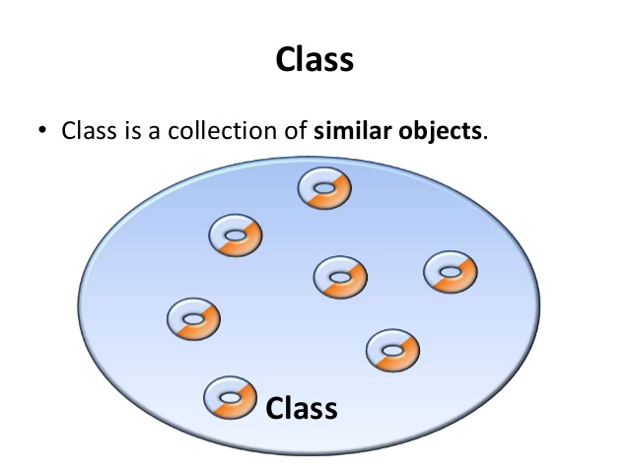
What is a Class?

Slide 17
Definition of Class
The class is the unstructured data type that encapsulates a fixed number of data components with the functions that manipulate them
It gives the C++ its identity from C
It makes possible encapsulation, data hiding and inheritance
Consists of both data and methods
Defines properties and behavior of a set of entities
Object:
An instance of a class
A variable identified by a unique name

Slide 18
Motivation for classes
Object-Oriented Programming (OOP)
Package together a set of related data and operations (encapsulation)
Define a class (abstract data type), or a new data type with its operations
One instance of a class is called an object
The data and operations of a class are called its members.

Slide 19
Classes & Objects
class Rectangle
{
private:
int width;
int length;
public:
void set(int w, int l);
int area();
}
Rectangle r1;
Rectangle r2;
Rectangle r3;

Slide 20
Define a Class Type
class Rectangle
{
private:
int width;
int length;
public:
void set(int w, int l);
int area();
};
class class_name
{
permission_label:
member;
permission_label:
member;
...
};

Slide 21
Class Definition – Member Functions
Used to
access the values of the data members (accessor)
perform operations on the data members (implementor)
Are declared inside the class body, in the same way as declaring a function
Their definition can be placed inside the class body, or outside the class body
Can access both public and private members of the class
Can be referred to using dot or arrow member access operator

Slide 22
Define a Member Function
class Rectangle
{
private:
int width, length;
public:
void set (int w, int l);
int area() {return width*length; }
}
class name
member function name
void Rectangle :: set (int w, int l)
{
width = w;
length = l;
}
r1.set(5,8);
rp->set(8,10);
inline
scope operator

Slide 23
Defining Methods Separately
For methods that are declared but not defined in the class we need to provide a separate definition
To define the method, you define it as any other function, except that the name of the function is
ClassName::FuncName
:: is the scope resolution operator, it allows us to refer to parts of a class or structure

Slide 24
Inline Functions
In an inline function, the C++ compiler does not make a function call, instead the code of the function is used in place of the function call (and appropriate argument substitutions made)
Why?
It is used to save the memory space when a function is likely to be called many times
Things like accessing/changing fields of a class instance should be fast
It is a direct request to the compiler

Slide 25
Class Definition - Access Control
Information hiding
To prevent the internal representation from direct access from outside the class
Access Specifiers
public
may be accessible from anywhere within a program
private
may be accessed only by the member functions, and friends of this class, not open for nonmember functions
protected
acts as public for derived classes (virtual)
behaves as private for the rest of the program
Difference between classes and structs in C++
the default access specifier is private in classes
the default access specifier is public in structs

Slide 26
Class in a Separate Header File for Reusability
Header files
Separate files in which class definitions are placed.
Allow compiler to recognize the classes when used elsewhere.
Generally have .h filename extensions
.cpp files for source-code implementations
Class implementations
Main programs
Test programs
Driver file
A program used to test software (such as classes).
Contains a main function so it can be executed

Slide 27
Example
//This is file DateType.h
Class DateType
{
public:
void Initialize (int newMonth, int newDay, int newYear);
int GetYear() const; //Returns year
int GetMonth() const; // Returns month
int GetDay() const; // Returns day
Private:
int year;
int month;
int day;
};

Slide 28
Three Types of Functions
Class member functions are classified into three categories:
Constructors
create objects (allocate memory, set initial state)
Modifiers
change the state of objects
Accessors
make information about the state of the object available outside the class

Slide 29
Constructor
Goal:
construct objects of the class
allocate memory
Constructors MUST have the same name as the class itself.
They don't have a return type. It's simply omitted.
That's how you'll make instances of the class (objects).
Example:
dateType class
constructor: dateType();
rectangle class
constructor: rectangle();

Slide 30
Constructor (Cont.)
Constructors can be overloaded
Can have several constructors
same name
different lists of parameters
This ability allows you to create
a default constructor
no parameters
initializer constructors
parameters specifying initial state of an object

Slide 31
Modifiers
The functions that do most of the work.
Note: Objects have three characteristics:
name
state
set of operations
Modifiers define the set of operations

Slide 32
Modifiers (Cont.)
Allow the client to make changes to the private variables.
Declarations look like the ones for nonmember functions.
Often, but not always, they have a void return type.
“Set” functions
Modifiers that just "set" the value of a private variable from a parameter without doing any calculations

Slide 33
Accessors
Allow the client to see what values the private variables have.
Don't allow the client to make changes.
Return type is that of the variable being "accessed."
"Get" functions
Accessors that just "get" the value of a private variable without doing any calculations

Slide 34
More complicated accessors
Some calculation based on the data
as long as it doesn’t change the member data
e.g. balance after interest w/o actually crediting it
A data member converted to different units
e.g. Fahrenheit version of Celsius temp.
Part of a data member
e.g. the cents part of a dollar amount

Slide 35
Pre- and Postconditions
Preconditions
What must be true for the method to behave as intended
Anything about the state of the object?
Should another method have been called first?
May need to look at private data members individually
Postconditions
What is the state of the object after this method has been called? What is returned or displayed?
What private data members have changed? How?

Slide 36
Objects
Object:
a variable or an instance of a class
OBJECT
set of methods
(public member functions)
internal state
(values of private data members)
Operations
Data

Slide 37
Declaration of an Object
class Rectangle
{
private:
int width;
int length;
public:
void set(int w, int l);
int area();
}
main()
{
Rectangle r1;
Rectangle r2;
r1.set(5, 8);
cout<<r1.area()<<endl;
r2.set(8,10);
cout<<r2.area()<<endl;
}

Slide 38
Another Example
// member function definitions
void circle::store(double r)
{
radius = r;
}
double circle::area(void)
{
return 3.14*radius*radius;
}
void circle::display(void)
{
cout << “r = “ << radius << endl;
}
#include <iostream.h>
class circle
{
private:
double radius;
public:
circle();
void store(double);
double area(void);
void display(void);
};
int main(void) {
circle c; // an object of circle class
c.store(5.0);
cout << "The area of circle c is " << c.area() << endl;
c.display();
}

